Slide 1
PSDA I: Binary Search Tree
Keluarga Mitosis

Slide 2
Syarat BST
<
Kurang dari Induk :)
>
Lebih dari Induk :)
KIRI
KANAN

Slide 3
Implementasi

Slide 4
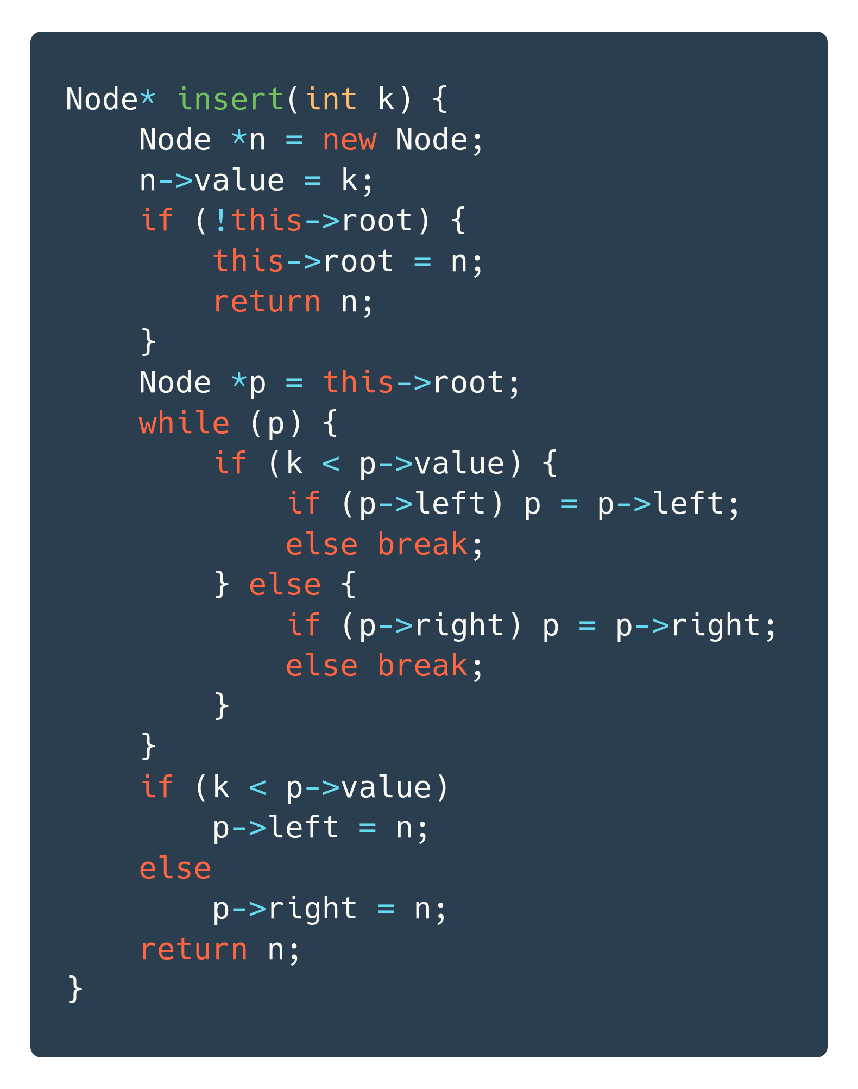
Insert

Slide 5
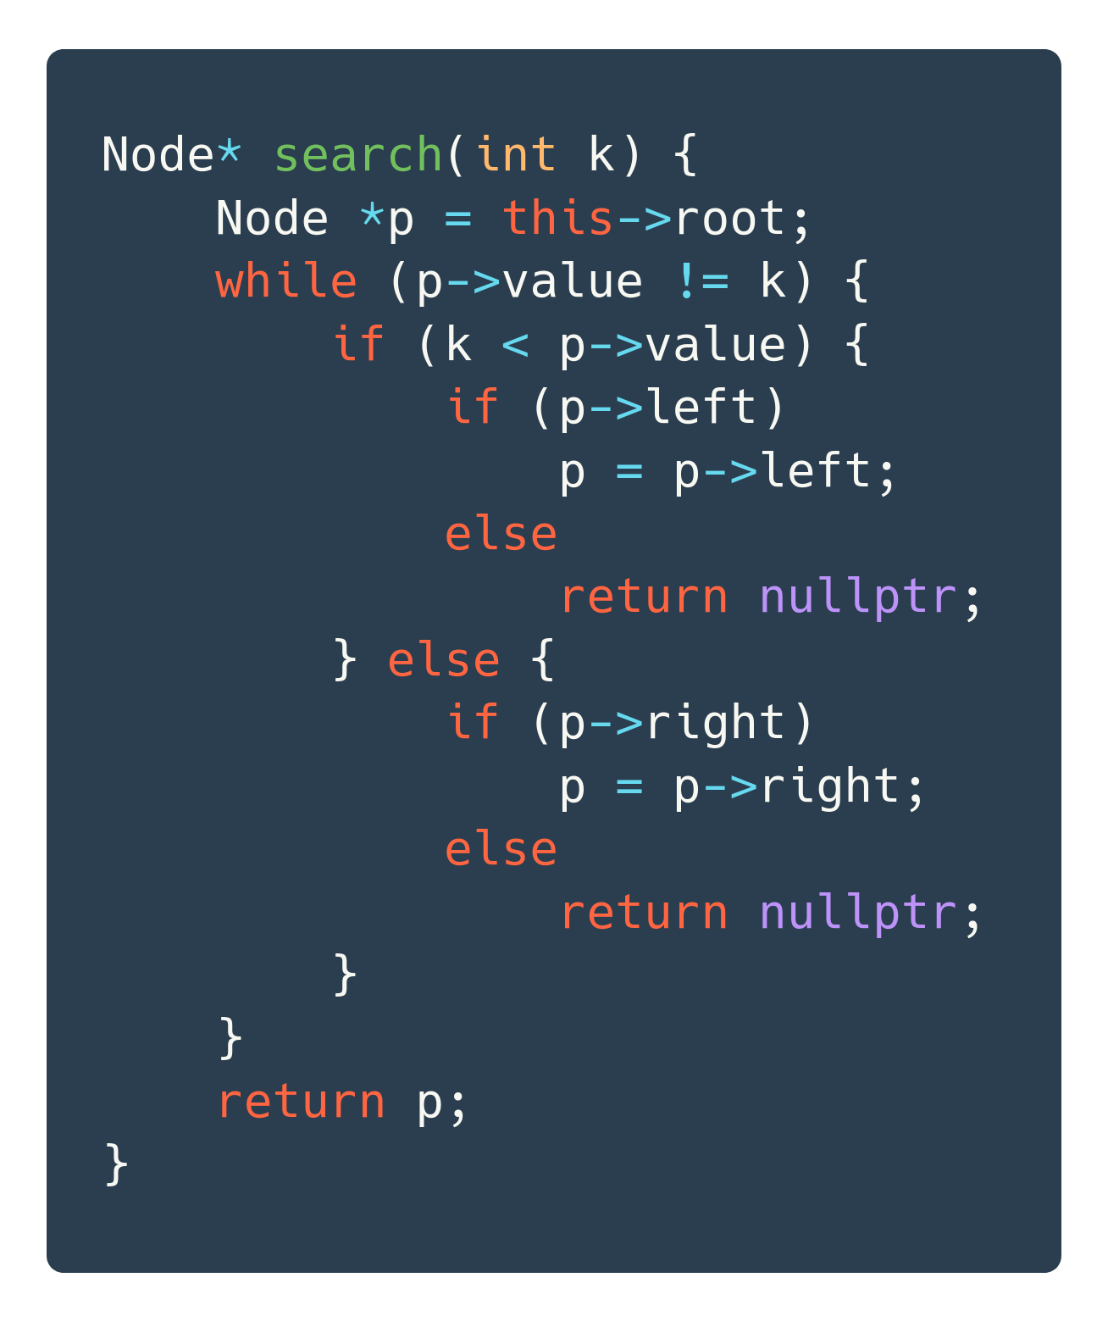
Search

Slide 6
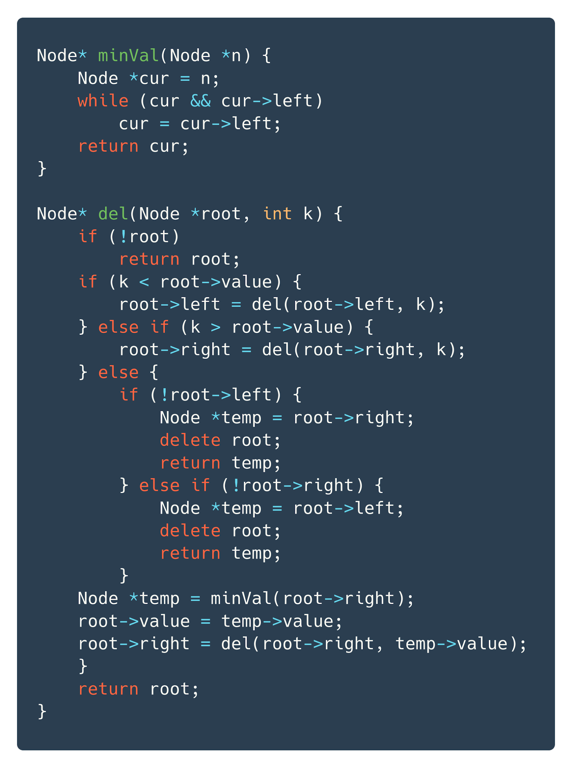
Delete
Node* minVal(Node *n) {
Node *cur = n;
while (cur && cur->left)
cur = cur->left;
return cur;
}
Node* del(Node *root, int k) {
if (!root)
return root;
if (k < root->value) {
root->left = del(root->left, k);
} else if (k > root->value) {
root->right = del(root->right, k);
} else {
if (!root->left) {
Node *temp = root->right;
delete root;
return temp;
} else if (!root->right) {
Node *temp = root->left;
delete root;
return temp;
}
Node *temp = minVal(root->right);
root->value = temp->value;
root->right = del(root->right, temp->value);
}
return root;
}
36

Slide 7
Praktikum

